Slide 1
Language Systems
Chapter 4
Programming Language Systems
A system (environment) for programmers to develops their programs in a certain programming language on a certain machine
What
How
ITK 327

Slide 2
Outline
The classical sequence
Variations on the classical sequence
Binding times
Debuggers
Runtime support
ITK 327

Slide 3
IDE The Classical Sequence
Integrated Development Environments
Here or there
Old-fashioned, un-integrated systems:
Step by step
ITK 327

Slide 4
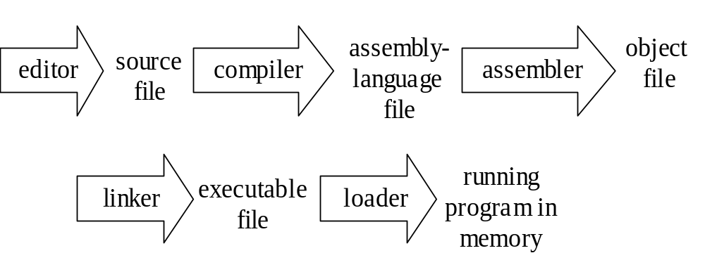
The Classical Sequence
ITK 327

Slide 5
Creating, Editing a program
The programmer uses an editor to create a text file containing the program
A high-level language: machine independent
A C-like program set:
int i;
void main() {
for (i=1; i<=100; i++)
fred(i);
}
fred:void (a:int){
i:int;
...
}
ITK 327

Slide 6
Compiling → assembly
Compiler translates to assembly language
Machine-specific
Each line represents either a piece of data, or a single machine-level instruction
Programs used to be written directly in assembly language, before Fortran (1957)
Now used directly only when the compiler does not do what you want, which is rare
ITK 327

Slide 7
i: data word 0
main: move 1 to i
t1: compare i with 100
jump to t2 if greater
push i
call fred
add 1 to i
go to t1
t2: return
int i;
void main() {
for (i=1;i<=100;i++)
fred(i);
}
Compiler
A
fred:void (a:int){
i:int;
...
}
Compiler
B
i: data word 0
a: data word 0
fred: ...
...
t1: return
ITK 327

Slide 8
....
cmp %o0, 100
ble .LL5
nop
b .LL3
....
.LL5:
sethi %hi(i), %o0
or %o0, %lo(i), %o0
ld [%o0], %o0
call fred, 0
nop
sethi %hi(i), %o0
or %o0, %lo(i), %o1
sethi %hi(i), %o0
or %o0, %lo(i), %o0
ld [%o0], %o0
add %o0, 1, %o0
st %o0, [%o1]
b .LL2
...
Sun
ITK 327

Slide 9
Assembling → object code
Assembly language is still not directly executable
  Still text format, readable by people
  Still has names, not memory addresses
Assembler converts each assembly-language instruction into the machine’s binary format: its machine language
Resulting object file not readable by people
ITK 327

Slide 10
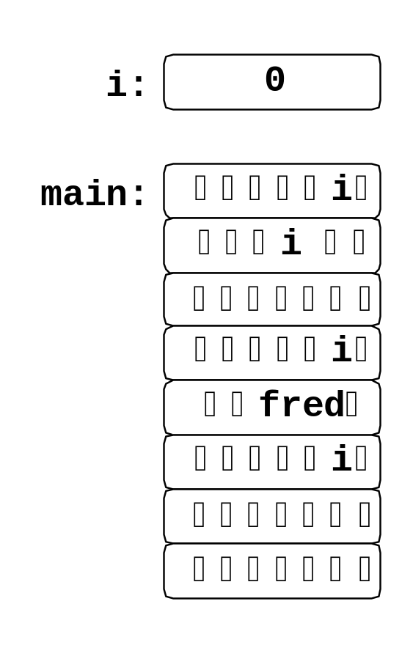
assembly
objective code
i: data word 0
main: move 1 to i
t1: compare i with 100
jump to t2 if greater
push i
call fred
add 1 to i
go to t1
t2: return
assembler
i:
a:
0
0
i: data word 0
a: data word 0
fred: ...
...
t1: return
fred:
¥•♥i♦≈
assembler
a♦ ¥•♥ @
$•♥i♦*
♦ a¥•♥ $
ITK 327

Slide 11
Linking → executable file
Object file still not directly executable
  Missing some parts
  Still has some names
  Mostly machine language, but not entirely
Linker collects and combines all parts
In our example, fred was compiled separately, and may even have been written in a different high-level language
Result is the executable file
ITK 327

Slide 12
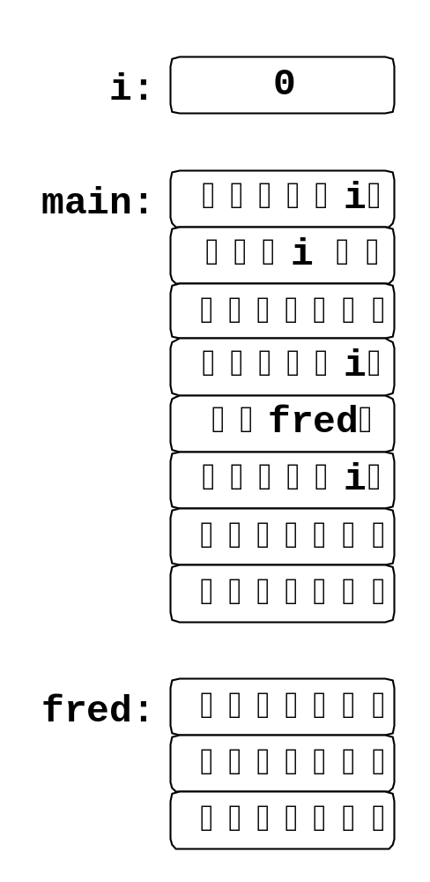
j:
a:
0
0
linker
i:
a:
0
0
fred:
¥•♥i♦≈
a♦ ¥•♥ @
$•♥i♦*
♦ a¥•♥ $
ITK 327

Slide 13
Loading
“Executable” file still not directly executable to the CPU
  Still has some names
  Mostly machine language, but not entirely
Final step: when the program is run, the loader loads it into memory and replaces names with addresses
ITK 327

Slide 14
Into the Memory
For our example, we are assuming a very simple kind of memory architecture (without paging, virtual memory…)
Memory organized as an array of bytes (words)
Index of each byte in this array is its address
Before loading, language system does not know where in this array the program will be placed
Loader finds an address for every piece and replaces names with addresses
ITK 327

Slide 15
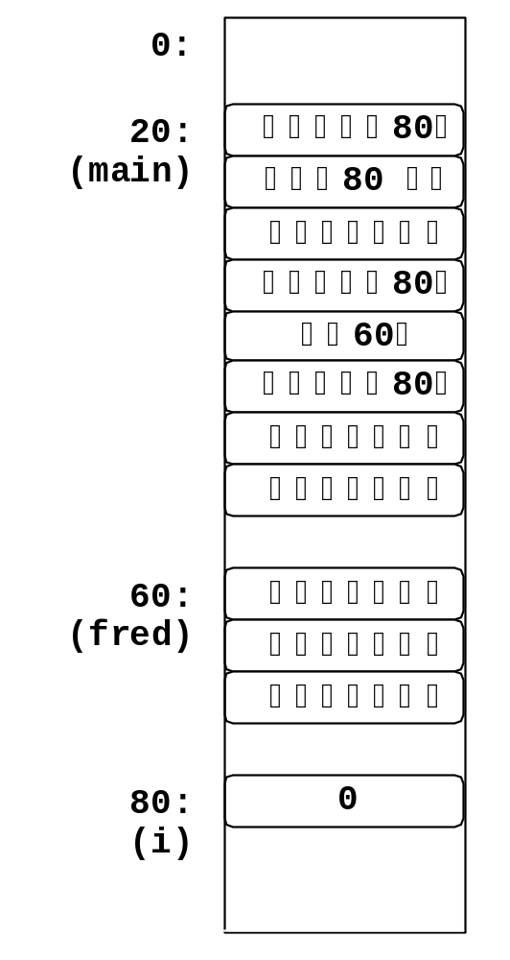
loader
ITK 327

Slide 16
Running
After loading, the program is entirely machine language
  All names have been replaced with memory addresses
Processor begins executing its instructions, and the program runs
With the help of OS
(or under the control)
ITK 327

Slide 17
About Optimization
Code generated by a compiler is usually optimized to make it faster, smaller, or both
Other optimizations may be done by the assembler, linker, and/or loader
The resulting code is not guaranteed to be optimal
ITK 327

Slide 18
A Trivial Example
Improved code, with loop invariant moved:
int i = 0;
int temp = x*x*x;
while (i < 100) {
a[i++] = temp;
}
int i = 0;
while (i < 100) {
a[i++] = x*x*x;
}
ITK 327

Slide 19
Example
Loop invariant removal is handled by most compilers
That is, most compilers generate the same efficient code from both of the previous examples
So it is a waste of the programmer’s time to make the transformation manually
(Good luck!)
ITK 327

Slide 20
Optimizations
hoisting
LIR (Loop Invariant Removal), add/remove variables, add/remove around, parallelizing, piping, paging…..etc.
(this are what 90% of modern compiler researchers are trying to do)
All make the connection between source code and object code more complicated
I.e., no simple answer to “What assembly language code was generated for this statement?”
ITK 327

Slide 21
Variation: Hiding The Steps
Many language systems make it possible to do the compile-assemble-link part with one command
Example: gcc command on a Unix system:
gcc main.c
gcc main.c –S
as main.s –o main.o
ld …
It generates object code directly
Compile-assemble-link
Compile,
then assemble,
then link
ITK 327

Slide 22
Integrated Development Environments
A single interface for editing, running and debugging programs
Integration can add power at every step:
  Editor knows language syntax
  System may keep a database of source code (not individual text files) and object code
  System may maintain versions, coordinate collaboration
  Rebuilding after incremental changes can be coordinated, like Unix make but language-specific
  Debuggers can benefit (more on this in a minute…)
ITK 327

Slide 23
Variation: Interpreters
To interpret a program is to carry out the steps it specifies, without first translating into a lower-level language
Interpreters are usually much slower
  Compiling takes more time up front, but program runs at hardware speed
  Interpreting starts right away, but each step must be processed in software
ITK 327

Slide 24
Virtual Machines
A language system can produce code in a machine language for which there is no real hardware: an intermediate code
Virtual machine must be simulated in software – interpreted, in fact
Language system may do the whole classical sequence, but then interpret the resulting intermediate-code program
Why?
ITK 327

Slide 25
Why Virtual Machines
Cross-platform execution
  Virtual machine can be implemented in software on many different platforms
  Simulating physical machines is harder
Heightened security
  Running program is never directly in charge
  Interpreter can intervene if the program tries to do something it shouldn’t
ITK 327

Slide 26
The Java Virtual Machine
Java languages systems usually compile to code for a virtual machine: the JVM
JVM language is sometimes called bytecode
Bytecode interpreter is a part of almost every Web browser
When you browse a page that contains a Java applet, the browser runs the applet by interpreting its bytecode
ITK 327

Slide 27
Delayed Linking
Delay linking, a linked “executable program” is not ready to go.
Code for library functions is not included in the executable program
ITK 327

Slide 28
Delayed Linking: Windows
Libraries of functions for delayed linking are stored in .dll files: dynamic-link library
Two flavors
  Load-time dynamic linking
    Loader finds .dll files (which may already be in memory) and links the program to functions it needs, just before running
  Run-time dynamic linking
    Running program makes explicit system calls to find .dll files and load specific functions
ITK 327

Slide 29
Delayed Linking: Unix
Libraries of functions for delayed linking are stored in .so files: shared object
Suffix .so followed by version number
Two flavors (similar to dll)
  Shared libraries
    Loader links the program to functions it needs before running
  Dynamically loaded libraries
    Running program makes explicit system calls to find library files and load specific functions
ITK 327

Slide 30
Delayed Linking: Java
JVM automatically loads and links classes when a program uses them
Class loader does a lot of work:
  May load across Internet
  Thoroughly checks loaded code to make sure it complies with JVM requirements
ITK 327

Slide 31
Delayed Linking Advantages
Multiple programs can share a copy of library functions: one copy on disk and in memory
Library functions can be updated independently of programs: all programs use repaired library code next time they run
Can avoid loading code that is never used
ITK 327

Slide 32
Profiling (advanced optimization)
The classical sequence runs twice
First run of the program collects statistics: parts most frequently executed
Second compilation uses this information to help generate better code
ITK 327

Slide 33
Dynamic Compilation
Some compiling tasks start after the program starts running.
This is know as Just-in-time (JIT) compilation.
Examples:
  Compile each function only when called
  Start by interpreting, then compile only those pieces that are called frequently
  Compile roughly at first (for instance, to intermediate code); spend more time on frequently executed pieces (for instance, compile to native code and optimize)
ITK 327

Slide 34
Binding
Binding means associating two things—especially, associating some property with an identifier from the program
Many characteristics of a language are determined by its binding times
E.g.
  What set of values is associated with int?
  What is the type of fred?
  What is the address of the object code for main?
  What is the value of i?
int i;
void main() {
for (i=1;i<=100;i++)
fred(i);
}
ITK 327

Slide 35
Binding Times
Different bindings take place at different times
Some are related to the classical sequence:
  Language definition time
  Language implementation time
  Compile time
  Link time
  Load time
  Runtime
ITK 327

Slide 36
Language definition time:
Binding is determined at:
  Meanings of keywords: void, for, etc.
Language implementation time
  range of values of type int in C
  (but in Java, these are part of the language definition)
  implementation limitations: max identifier length, max number of array dimensions, etc
ITK 327

Slide 37
Link time
Binding is determined at:
Compile time
  Types of variables, (C and ML that use static typing)
  The activate space for a declared variable (static scoping, most languages)
  Object code for external function names
int i;
void main() {
for (i=1;i<=100;i++)
fred(i);
}
ITK 327

Slide 38
Run time
Binding is determined at:
int i;
void main() {
for (i=1;i<=100;i++)
fred(i);
}
Load time
  Memory locations for code for functions
  Memory locations for static variables
  Values of variables
  Types of variables (Lisp uses dynamic typing)
  The activate space for a declared variable (dynamic scoping)
Also called late or dynamic binding (everything before run time is early or static)
ITK 327

Slide 39
Debugging Features
Examine a snapshot, such as a core dump
Examine a running program on the fly
  Single stepping, breakpointing, modifying variables
Modify currently running program
  Recompile, relink, reload parts while program runs
Advanced debugging features require an integrated development environment
ITK 327

Slide 40
Debugging Information
Where is it executing?
What is the traceback of calls leading there?
What are the values of variables?
Source-level information from machine-level code
  Variables and functions by name
  Code locations by source position
Connection between levels can be hard to maintain, for example, because of optimization
ITK 327

Slide 41
Runtime Support
-- An important hidden player in language systems
Additional code the linker includes but the program does not refer to it explicitly
  Startup processing: initializing the machine state
  Exception handling: reacting to exceptions
  Memory management: allocating memory, reusing it when the program is finished with it
  Operating system interface: communicating between running program and operating system for I/O, etc.
ITK 327

Slide 42
Conclusion
Language systems implement languages
Today: a quick introduction
More implementation issues later, especially:
  Chapter 12: memory locations for variables
  Chapter 14: memory management
  Chapter 18: parameters
  Chapter 21: cost models
ITK 327

